Slide 1
DATA VISUALIZATION
SINGLE DOCUMENT VISUALIZATION
DOCUMENT COLLECTION VISUALIZATION
30/05/2022

Slide 2
SINGLE DOCUMENT VISUALIZATION
Here we present several visualizations of a single text document.
TAG CLOUD
WORD TREE
TEXT ARC
ARC DIAGRAMS
LITERATURE FINGER PRINTING

Slide 3
SINGLE DOCUMENT VISUALIZATION

Slide 4
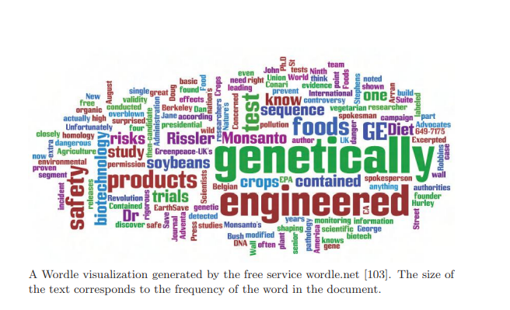
TAG CLOUD
A tag cloud visualization generated by the free service tagCrowd.com. The font size and darkness are proportional to the frequency of the word in the document.
Tag clouds, also known as text clouds or word clouds, are layouts of raw tokens, colored and sized by their frequency within a single document.
Text clouds and their variations, such as a Wordle, are examples of visualizations that use only term frequency vectors and some layout algorithm to create the visualization.

Slide 5
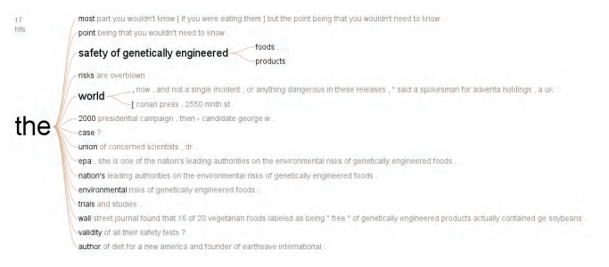
WORDTREE
Tag clouds, also known as text clouds or word clouds, are layouts of raw tokens, colored and sized by their frequency within a single document.
Text clouds and their variations, such as a Wordle, are examples of visualizations that use only term frequency vectors and some layout algorithm to create the visualization.

Slide 6
TEXTARC
We can extend the representation of word distribution by displaying connectivity. There are several ways in which connections can be computed.
A TextArc visualization that uses the full text of Alice in Wonderland. Words that occur evenly throughout the document are positioned in the center of the display, while words that appear only in specific sections are located closer to the circumference.
Every word of the text is drawn in order around an ellipse as small lines with a slight offset at its start. As in a text cloud, more frequently occurring words are drawn larger and brighter.
Words with higher frequencies are drawn within the ellipse, pulled by its occurrences on the circle (similar to RadViz). The user is able to highlight the underlying text with probing and animate “reading” the text by visualizing the flow of the text through relevant connected terms.

Slide 7
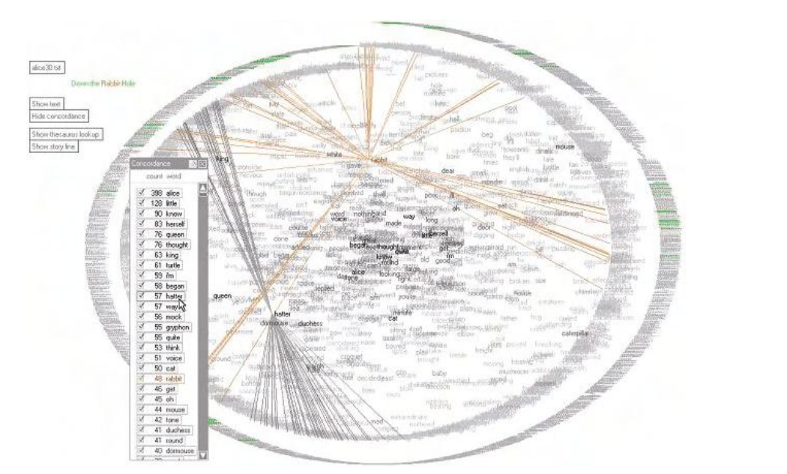

Slide 8
ARC DIAGRAMS
Arc diagrams are a visualization focused on displaying repetition in text or any sequence. Repeated subsequences are identified and connected by semicircular arcs.
The thickness of the arcs represents the length of the subsequence, and the height of the arcs represents the distance between the subsequences.
It contains two parts, each consisting of a long passage played twice. The parts are loosely related, as shown by the bundle of thin arcs connecting the two main parts. The overlap of the two main arcs shows that the end of the first passage is the same as the beginning of the second

Slide 9
LITERATURE FINGERPRINTING
Literature fingerprinting is a method of visualizing features used to characterize text.
Instead of calculating just one feature value or vector for the whole text (this is what is usually done), we calculate a sequence of feature values per text and present them to the user as a characteristic fingerprint of the document.
This allows the user to “look inside” the document and analyse the development of the values across the text. Moreover, the structural information of the document is used to visualize the document on different levels of resolution.

